Slide 1
Temperature vs. Humidity in Atlanta, Georgia
Madeline becker and jonathan hough

Slide 2
Introduction
In Atlanta, Georgia, studies have said that there is a necessity for high humidity during the colder months of the year.
Lack of humidity during these winter months:
Breathing issues
Cracking furniture and floors
Dry skin/nose/lips
Sicknesses

Slide 3
The Problem
We are interested in this topic because, living in Blacksburg this year, we’ve seen first-hand how the colder seasons can affect your lives.
We are wondering if humidity has anything to do with this, and if so if there is a correlation between temperature and humidity.
If there is a correlation, this could help someone prone to illnesses know the advantages and disadvantages to living in a state with a generally warm climate versus living in a state with a generally cold climate.
We wanted to research this because, while looking for how people have addressed this problem in the past, nobody has really considered humidity’s role in all of this.

Slide 4
Dataset
We used a dataset consisting of the high temperatures, low temperatures, and rates of humidity at 12pm everyday from January 1st, 2018 to March 31st, 2018 – exactly 3 months.
We retrieved this data from www.timeanddate.com, a site that has the history of weather in the US, as far back as 2009. We plugged the high temperatures, low temperatures, and humidity rates of Atlanta, Georgia into an Excel spreadsheet by hand, and converted it to a comma-separated values file.
We will compare the temperatures and the humidity rates that we found to address our problem.

Slide 5
Methods
We used Jupyter to further research the relationship between our data.
We merged the two files, one with high temperature and humidity, and the other with low temperature and humidity.
It ended with one big list, so we converted the list into a dictionary.
From the dictionary, we found the mean, max, min, and quartiles for each key.
Scatterplot
Line of best fit

Slide 6
Results
High temperature (degrees F):
Mean: 58.14
Min: 25
1st quartile: 50.5
Median: 59
3rd quartile: 65.6
Max: 81
Low temperature (degrees F):
Mean: 52.96
Min: 19
1st quartile: 45
Median: 54
3rd quartile: 61
Max: 77
Humidity (%):
Mean: 54.84
Min: 16
1st quartile: 33
Median: 49
3rd quartile: 74
Max: 100

Slide 7
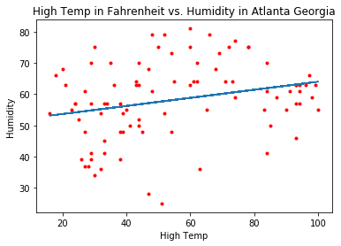
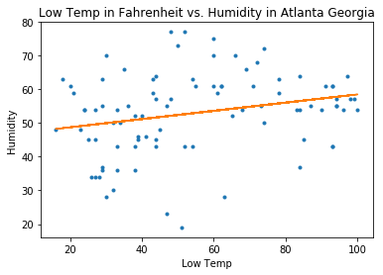
Results
r = 0.239751
r = 0.263109

Slide 8
Conclusion
These results addressed the problem in that they showed that there is no significant correlation between temperature and humidity.
Therefore, the consequences due to a lack of humidity are not related to temperature, and can happen year round.

Slide 9
Challenging Code
header = big_data[0]
big_data_dict = {}
for line in big_data[1:]:
for i,a in enumerate(header):
if a not in big_data_dict:
big_data_dict[a] = []
try:
big_data_dict[a].append(float(line[i]))
except ValueError:
big_data_dict[a].append(line[i])
print big_data_dict

Slide 10
Citations
https://www.peoplespharmacy.com/2015/12/07/misdiagnosed-cough-from-hell-makes-life-miserable/
https://www.pinterest.co.uk/pin/464855992776790353/
https://www.vectorstock.com/royalty-free-vector/the-thermometer-icon-high-and-low-temperature-vector-5468948
https://www.timeanddate.com/weather/usa/atlanta/historic?month=3&year=2018
https://oconeeclimatecontol.com/need-humidity-winter-months-georgia-home/

